Slide 1
Ethics hour

Slide 2
Proposed rule 5(b): Beginning and concluding collaborative process
Collaborative law is voluntary
a tribunal may not order a party to participate in a collaborative law process over that party’s objection.

Slide 3
Elements
Voluntary, early disclosure of information
Duty of honesty and candor
Settlement as a goal
Participatory process
Transparency
Joint retention of experts
Recognizing goals of both parties
Avoiding threat of litigation
Disqualification of attorneys and experts if settlement fails
Four-way meetings

Slide 4
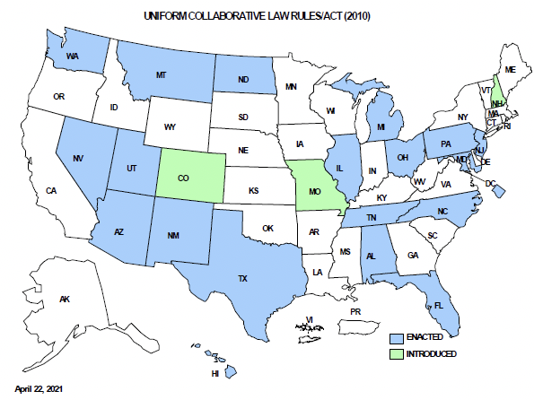
20 states and the District of Columbia have adopted a version of the Uniform Rules for Collaborative Practice.

Slide 5
Proposed Rule 4: Collaborative Law Participation Agreement
A collaborative law participation agreement must:
be in a record signed by the parties;
state the parties’ intention to resolve a matter through a collaborative process under this Rule;
describe the nature and scope of the matter;
identify the collaborative lawyer who represents each party in the process;
contain a statement by each lawyer confirming their representation of a party in the process; and
contain a statement that the parties will forego court intervention while using the process; a statement that they will jointly engage experts in a neutral capacity; and a statement about mandatory disqualification of the collaborative lawyer.

Slide 6
Benefits to lawyers
Collaborative Law is advantageous for attorneys.
It promotes civility among them. Attorneys are able to collaborate on cases for the benefit of the parties rather than being adversaries.
Collaborative Law is advantageous for Courts.
Assuming Collaborative Law is successful it should lessen post-divorce issues since the parties agreed on the resolution.
It limits court involvement, assisting courts that have a backlog of cases and promoting judicial efficiency.

Slide 7
Limited services
Proposed Rule 4 states:
Participation of Collaborative Law attorneys is limited in scope as permitted by Rule 1.2(c) of the Mississippi Rules of Professional Conduct.
Miss. R. Prof. Resp Rule 1.2(c) provides, “A lawyer may limit the objectives or scope of the representation if the limitation is reasonable under the circumstances and the client gives informed consent.” The comments state that “the terms upon which representation is undertaken may exclude specific means that might otherwise be used to accomplish the client's objectives.” Miss. R. Prof. Resp Rule 1.2(c), Comment.

Slide 9
Proposed Rule 18: Waiver and Preclusion of Privilege
A privilege under Rule 17 may be waived in a record or orally during a proceeding if it is expressly waived by all parties and, in the case of the privilege of a nonparty participant, it is also expressly waived by the nonparty participant.

Slide 10
Benefits to clients
Collaborative Law is advantageous for clients
It provides promotes positive relationships between the parties (usually parents) that can be sustained through and post-divorce.
It provides a resolution pathway that fosters less conflict and allows for a better coparenting relationship.
It can be more economical without the added expenses for discovery, litigation preparation and court hearings.

Slide 11
The Proposed rules do not alter the rules of professional responsibility
Proposed Collaborative Law Rule 13 provides:
“This Rule does not affect: (1) the professional responsibility obligations and standards applicable to a lawyer or other licensed professional; or (2) the obligation of a person to report abuse or neglect, abandonment, or exploitation of a child or adult under the law of this state.”

Slide 12
Does the withdrawal requirement violate ethics rules?
Miss. R. Prof. Resp Rule 1.2(c) provides,
“A lawyer may limit the objectives or scope of the representation if the limitation is reasonable under the circumstances and the client gives informed consent.”

Slide 13
Informed consent
Proposed Rule 14: A lawyer should
Assess whether collaborative law is appropriate in this case
Advise the client of the benefits and risks as compared to those of other options (mediation, litigation)
Proposed Rule 14 requires that the lawyer advise the client
That the process terminates if litigation is initiated
That the lawyer and their firm are disqualified from litigation
That the process is voluntary and may be terminated at any time.

Slide 14
the lawyer’s duty of diligence
Miss. R. Prof. Resp. 1.4 states that lawyers must act with “reasonable diligence” on behalf of a client.
The comments state that “A lawyer should act with commitment and dedication to the interests of the client and with zeal in advocacy upon the client's behalf. However, a lawyer is not bound to press for every advantage that might be realized for a client.”

Slide 15
Does the process violate confidentiality rules?
Miss. R. Prof. Resp. provides,
“A lawyer shall not reveal information relating to the representation of a client unless the client gives informed consent [or] the disclosure is impliedly authorized in order to carry out the representation.”
The attorney should advise the client regarding information that must be shared voluntarily and ensure that the client makes an informed consent to that aspect of the process.

Slide 16
Does the four-way process create a conflict of interest?
Miss. R. Prof. Resp. 1.7 provides:
(b) A lawyer shall not represent a client if the representation of that client may be materially limited by the lawyer's responsibilities to another client or to a third person, or by the lawyer's own interests, unless the lawyer reasonably believes: (1) the representation will not be adversely affected; and(2) the client has given knowing and informed consent after consultation. The consultation shall include explanation of the implications of the representation and the advantages and risks involved.

Slide 17
Proposal for unilateral divorce
“It is the overwhelming consensus of the Task Force that legislative action must be taken to amend Mississippi Code Annotated 93-5-1 to provide for an additional fault grounds for divorce based on a finding of an irretrievable breakdown of the marriage and/or complete incompatibility between spouses.”
“An example of statutory language would be: The chancery court may divorce persons upon application of either party, when the court finds there has been an irretrievable breakdown of the marriage and that further attempts at reconciliation are impractical or futile and not in the best interests of the parties or family.” Task Force Report, Recommendation #1

Slide 18
Reasons for recommendation #1
The current system
Does not save marriages
Allows divorce blackmail
Uses scarce court resources
Increases the costs of divorce
Embitters spouses
Negatively affects victims of domestic violence
Makes it more difficult for pro se litigants
Prevents spouses and children from moving forward with their lives

Slide 19
Recommendation # 3
Administrative Suspension of Child Support due to Incarceration
The Task Force unanimously recommends the creation of a code section to authorize the administrative suspension of child support for non-custodial parents who are incarcerated in jail or prison for more than 180 days. Under the Flexibility, Efficiency and Modernization in Child Support Enforcement Programs final rule2, Mississippi may not exclude the consideration of incarceration as a material change in circumstance in establishing and modifying child support obligations.

Slide 20
Support for adult disabled children
Recommendation No. 2:
“The Task Force unanimously supports the creation of a presumption that child support for a child with a disability that renders the child incapable of self-support should continue past the age of majority.”
“Legislation should also give the court authority to consider the adult child’s receipt of and eligibility for public benefits and community resources in determining the award of support.”
Task Force Report, Recommendation #2

