Slide 1
candor requires disclosure, not surrender
Integrate the authority into a larger synthesis
Emphasize hierarchy
Present adverse authority in a dependent clause
Concede, distinguish, and redirect
Reframe the holding narrowly
Rely on policy to undermine the authority
Invoke subsequent criticism
Emphasize timing
If credible, describe the case as dicta

Slide 2
Integrate the Authority into a Larger Synthesis
Mississippi courts consistently characterize § 91-1-15(3)(c) as a mandatory, self-executing limitation on inheritance claims. The Estate of Lewis Court, applying longstanding precedent, held that the statute is a nonclaim statute incapable of waiver. Est. of Lewis v. Thomas, 422 So. 3d 484, 493 (Miss. Ct. App. 2025) (citing Smith ex rel. Young v. Est. of King, 579 So. 2d 1250, 1254 (Miss. 1991)); but see Est. of Dorsey v. Matory, No. 2024-CA-00925-COA, 2025 WL 3524732, at *7 (Miss. Ct. App. Dec. 9, 2025) (applying equitable principles where administrator publicly identified claimant as decedent's child, delayed opening estate for three years, and invoked delay as bar).

Slide 3
Emphasize hierarchy
Both Lewis and Dorsey are Court of Appeals decisions. To the extent they appear in tension, this Court should follow the Mississippi Supreme Court's repeated characterization of § 91-1-15(3)(c) as a self-executing limitation. E.g., Smith ex rel. Young v. Est. of King, 579 So. 2d 1250, 1254 (Miss. 1991). Lewis is more consistent with those supreme court authorities.

Slide 4
Present Adverse Authority in a Dependent Clause
Although the Dorsey Court declined to apply the one-year limitation under unusual equitable circumstances, in Lewis the court reaffirmed that § 91-1-15(3)(c) is a self-executing nonclaim statute that ordinarily bars untimely heirship claims.

Slide 5
Concede, Distinguish, and Redirect
The Estate acknowledges that Dorsey supports the proposition that equity may affect the application of § 91-1-15(3)(c) in extraordinary circumstances. But Dorsey involved an administrator who publicly recognized the claimant as an heir, delayed administration for nearly three years, and then invoked the resulting delay against him. Those circumstances are absent here, and Lewis remains the better guide.

Slide 6
Reframe the Holding Narrowly
In Dorsey, the court recognized a narrow exception to the general rule. There, the court addressed a highly unusual situation in which the administrator's own conduct allegedly induced reliance by publicly recognizing the claimant as an heir while waiting years to commence administration.

Slide 7
Rely on Policy to Undermine the Authority
Extending Dorsey beyond its unique facts would undermine the certainty that nonclaim statutes are designed to provide. Estates require finality; allowing equitable exceptions whenever family members acknowledge a relationship would substantially weaken the Legislature's chosen limitation period.

Slide 8
candor requires disclosure, not surrender
Integrate the authority into a larger synthesis
Emphasize hierarchy
Present adverse authority in a dependent clause
Concede, distinguish, and redirect
Reframe the holding narrowly
Rely on policy to undermine the authority
Invoke subsequent criticism
Emphasize timing
If credible, describe the case as dicta

Slide 9
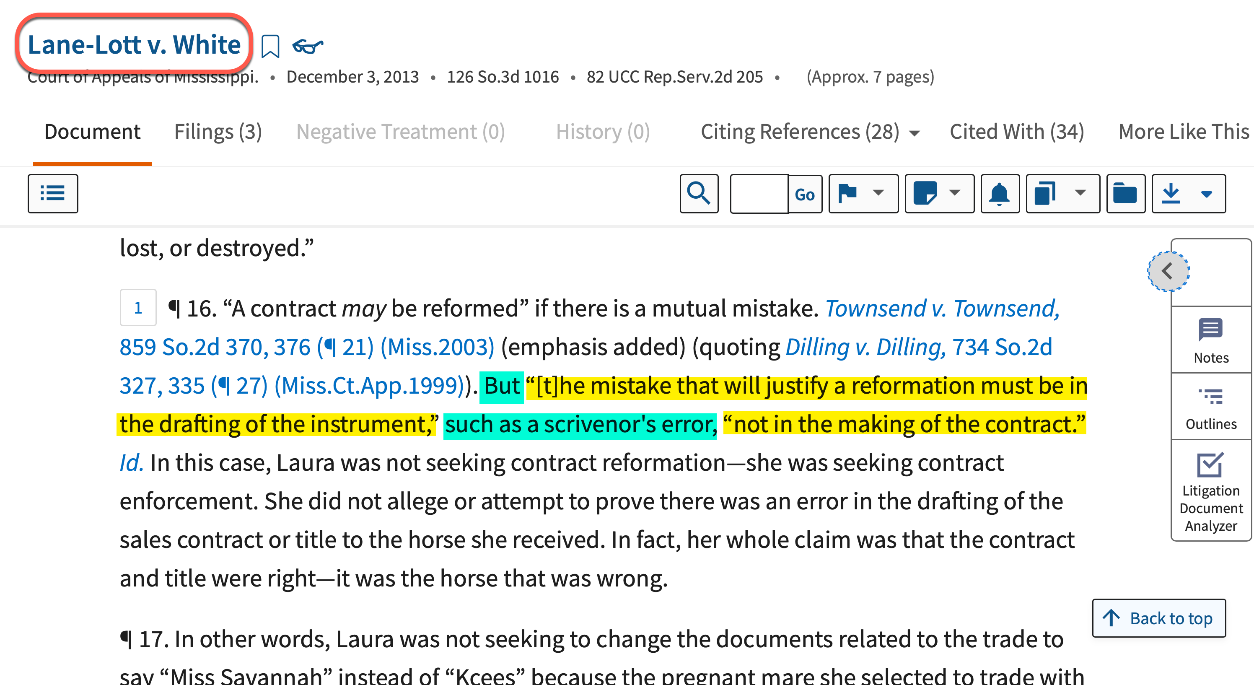

Slide 10
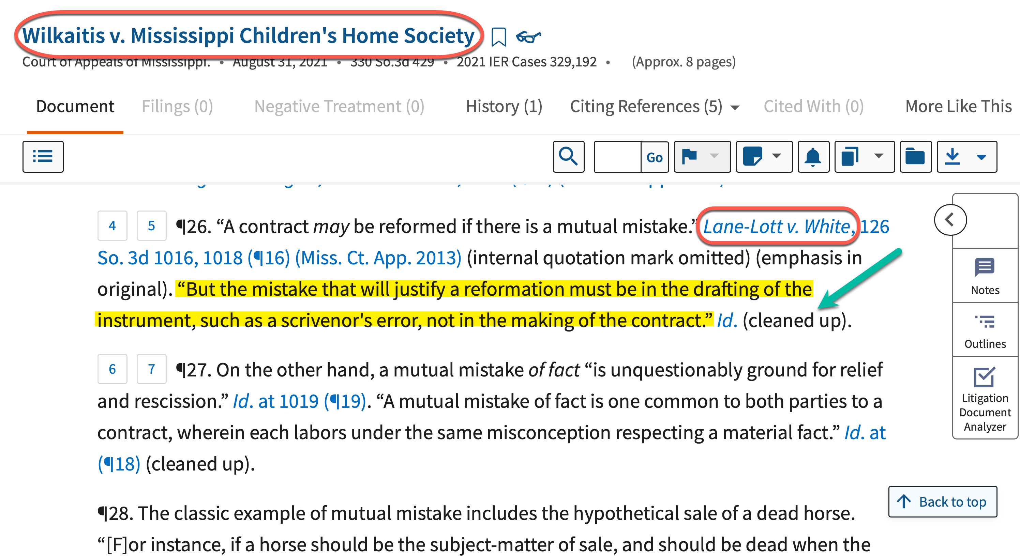

Slide 11
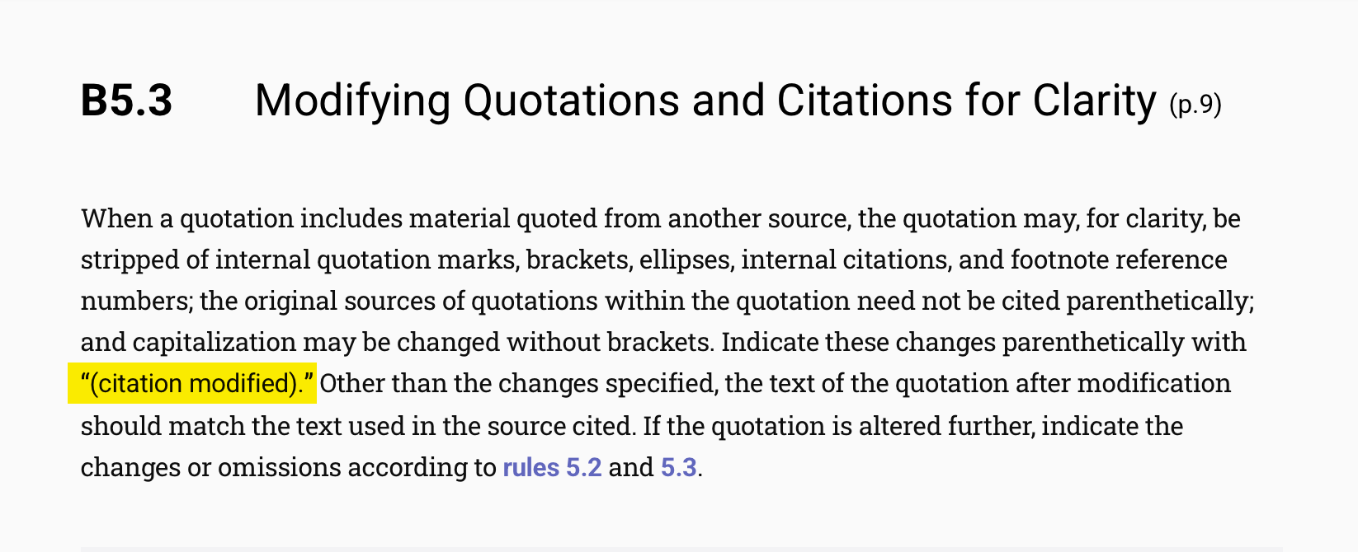
Bluebook Rule B5.3: “(citation Modified)”

